Slide 1

Machine Learning
Basics

Slide 2
Artificial Intelligence vs Machine learning
Artificial Intelligence
Machine learning
Vs
Computers act on their own
They act according to environment
Systems display cognitive ability
Computers make decisions
It’s an application of AI
Computers observe and analyze
Predict based on previous patterns
Pre-programmed algorithms

Slide 3
AI vs ML vs DL
AI is an umbrella discipline that covers everything related to making machines smarter
Artificial intelligence
Machine learning
Machine Learning (ML) is commonly used along with AI but it is a subset of AI.
Deep learning
Deep Learning (DL) is a machine learning (ML) applied to large data sets

Slide 4
Brief on AI History Timeline
1950s
1
1960s
2
1970s
3
1980s
4
Simple algorithms
Bayesian methods
AI winter caused by pessimism
Resurgence in ML research
1990s
5
2000s
6
2010s
7
Data-driven approach
Support-Vector Clustering
Deep learning popularity

Slide 5
Machine learning disadvantages
Continuous improvement
01
Data acquisition
02
Patterns identification
03
Time and resources
04

Slide 6
Some Applications of ML
1
2
Image recognition
Customization
3
4
Voice recognition
Opportunities of machine learning
Data analysis
5
6
Optical recognition
Memory data

Slide 7
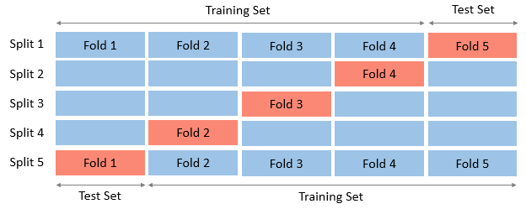
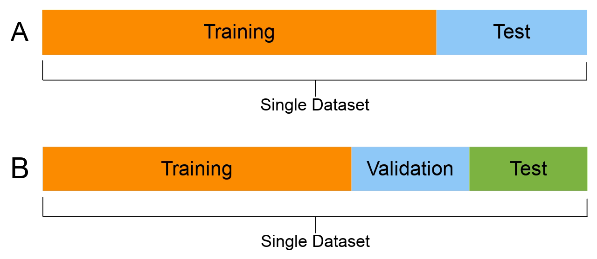
Dataset Splitting
Train_test_split (hold-out)
Cross- validation
The hold-out method is good to use when you have a very large dataset, you’re on a time crunch, or you are starting to build an initial model in your data science project
Cross-validation is usually the preferred method because it gives your model the opportunity to train on multiple train-test splits. This gives you a better indication of how well your model will perform on unseen data

Slide 8
Machine Learning Sectors
01 | Supervised learning
 | Ex : Regression, Decision Tree, Random Forest, KNN, Logistic Regression
02 | Unsupervised learning
 | Ex : K-Means Clustering, Principal Component Analysis and Hierarchical Clustering
03 | Reinforcement learning
 | Ex : Q – Learning ( most used algorithm )
04 | Dimensionality reduction
 | Ex : Principal Component Analysis , Singular Value Decomposition, Linear Discriminant Analysis

Slide 9
Supervised Learning
Classification
Logistic Regression
support vector machines (SVM)
Decision trees
k-nearest neighbour
Naive Bayes
Random Forest
Machine learning objectives
Regression
Decision Tree
Support Vector Regression
Cat Regression
Random Forest

Slide 10
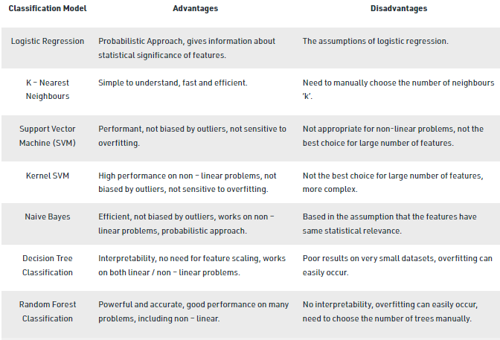
Classifiers

Slide 11
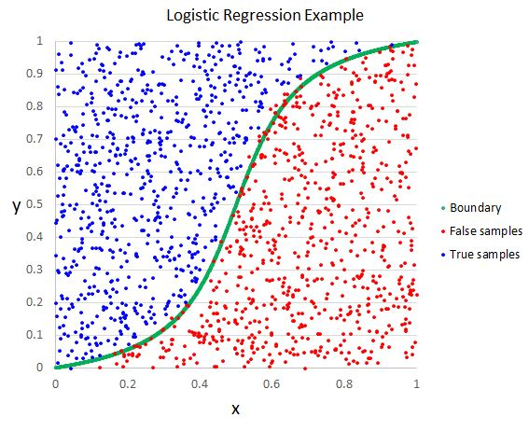
Logistic Regression
Logistic Regression is a linear classification model ( and hence, the prediction boundary is linear ), which is used to model binary dependent variables. It is used to predict the probability (p) that an event occurs. If p >= 0.5, the output is 1 else 0. The sigmoid function maps the probability value to the discrete classes (0 and 1)

Slide 12
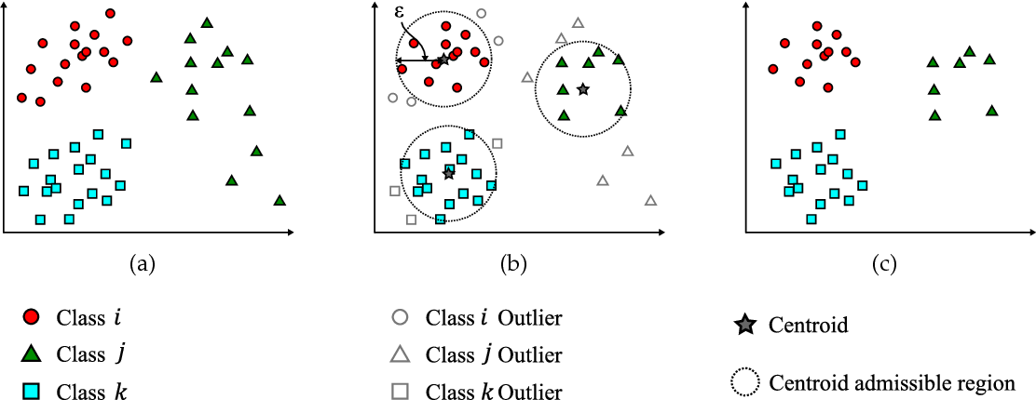
K – Nearest Neighbours (KNN)
K – Nearest Neighbours is a non – linear classifier (and hence, the prediction boundary is non-linear) that predicts which class a new test data point belongs to by identifying its k nearest neighbours' class. We select these k nearest neighbours based on Euclidean distance. Among these k neighbours, the number of data points in each category is counted, and the new data point is assigned to that category where we got the most neighbours in.

Slide 13
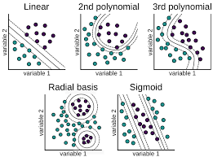
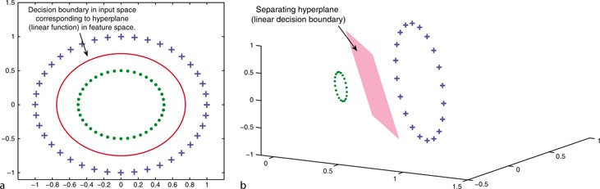
Support Vector Machine (SVM)
Support Vector Machine (SVM) is used as a linear or non-linear classifier based on the kernel used. If we use a linear kernel, then the classifier and hence the prediction boundary are linear. Here, to separate two classes, we need to draw a line. The line is such that there is a maximum margin. This line is drawn equidistant from both the sets. We draw two more lines on either side, and these are known as support vectors. SVMs learn from the support vectors, unlike other machine learning models that learn from the correct and incorrect data. For example, suppose we have two classes – apples and oranges. In that case, SVM learns those examples which are rightmost in apples (an apple resembling an orange) and leftmost in oranges (an orange resembling an apple); that is, they look at the extreme cases. Therefore, they perform better most of the time.

Slide 14
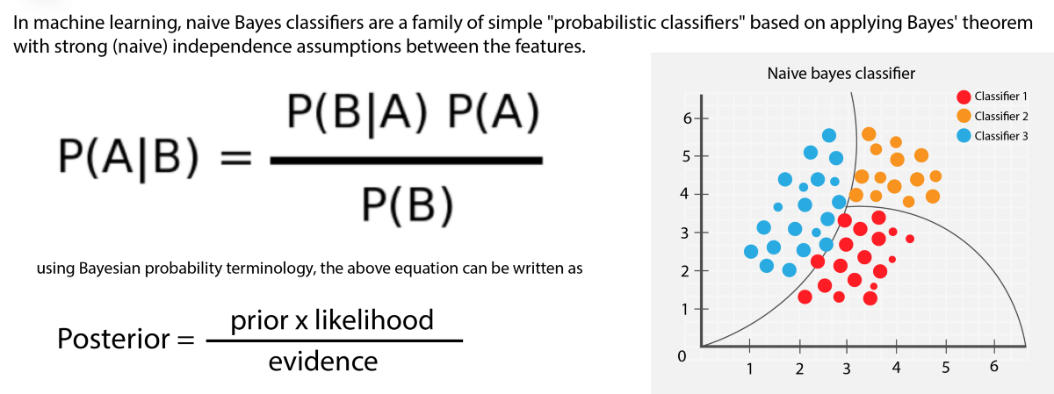
Naive Bayes Classifier
Naive Bayes Classifier works on the basis of Bayes’ Theorem. The fundamental assumptions made are that all the features are independent of one another and contribute equally to the outcome; all are of equal importance. But these assumptions are not always valid in real life (disadvantage of Naive Bayes). It is a probabilistic classifier model whose crux is the Bayes’ theorem.

Slide 15
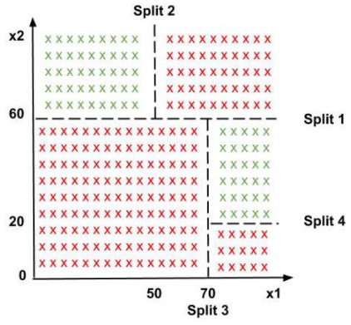
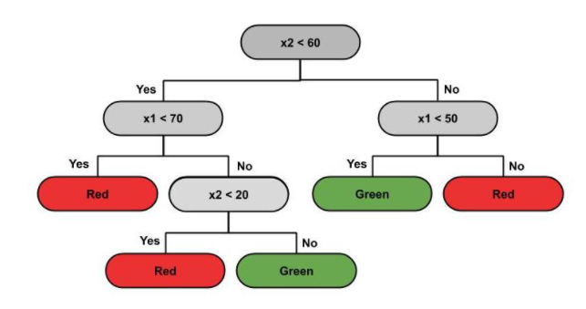
Decision Tree Classification
Decision Tree Classification is the most powerful classifier. A Decision tree is a flowchart like a tree structure, where each internal node denotes a test on an attribute (a condition), each branch represents an outcome of the test (True or False), and each leaf node (terminal node) holds a class label. Based on this tree, splits are made to differentiate classes in the original dataset given. The classifier predicts which of the classes a new data point belongs to based on the decision tree. The prediction boundaries are horizontal and vertical lines.

Slide 16
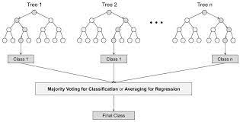
Random Forest Classification
Random Forest Classification is an example of Ensemble learning, where multiple machine learning algorithms are put together to create one bigger and better performance ML algorithm. We randomly pick ‘k’ data points from the training set, build a decision tree associated with these k points. Then, we choose the number of trees ‘n’ we want to build and repeat. For a new data point, we take the predictions of each of the ‘n’ decision trees and assign it to the majority vote category.

Slide 17
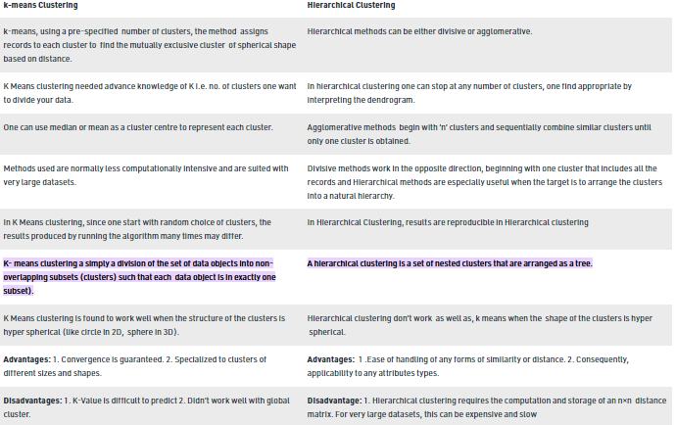
Unsupervised Learning

Slide 18
Types of Fittings
Fittings
Under Fitting
Exact Fit
Over Fitting

Slide 19
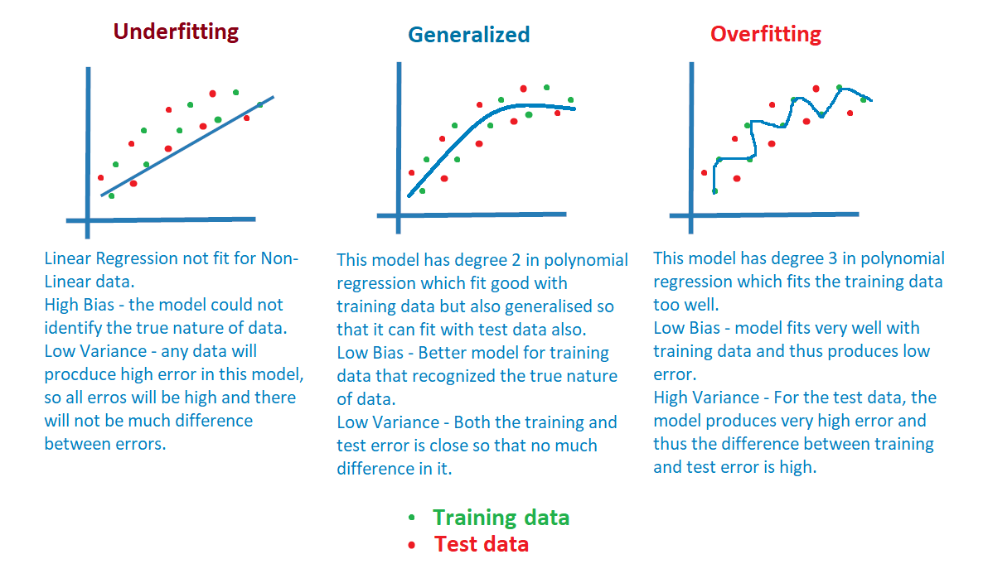
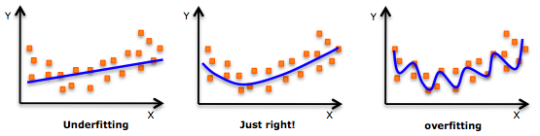
Underfitting in Machine Learning
Underfitting refers to a model that can neither model the training data nor generalize to new data.
An underfit machine learning model is not a suitable model and will be obvious as it will have poor performance on the training data.
Underfitting is often not discussed as it is easy to detect given a good performance metric. The remedy is to move on and try alternate machine learning algorithms. Nevertheless, it does provide a good contrast to the problem of overfitting.

Slide 20
Good Fit in Machine Learning
Ideally, you want to select a model at the sweet spot between underfitting and overfitting.
This is the goal, but is very difficult to do in practice

Slide 21
Overfitting in Machine Learning
Overfitting happens when a model learns the detail and noise in the training data to the extent that it negatively impacts the performance of the model on new data. This means that the noise or random fluctuations in the training data is picked up and learned as concepts by the model. The problem is that these concepts do not apply to new data and negatively impact the models ability to generalize.

Slide 22
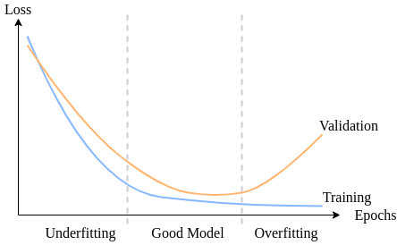
Fitting (Loss vs Epochs)

